Slide 1

Types of Sockets
Local Sockets
  Communication between different processes within Local System
Remote Sockets
  Connection-oriented (TCP)
    Echo Server
    Concurrent Server
    I/O Multiplexing
  Connection less(UDP)

Slide 2
Local Sockets
Each communication protocol specifies its own format for its networking address.
Address family indicates type of addressing is being used.
The constant AF_LOCAL (AF_UNIX) specifies that the address will be formed according to local (UNIX) address rules.
The constant AF_INET indicates that the address will conform to IP address rules
Local Addresses are used by sockets that are local to the host
Local address family has been referred to as the AF_UNIX domain (for example, a UNIX socket address).
These addresses uses local UNIX filenames to act as the socket name.

Slide 3
Generic Socket Address
Because the socket interface was developed before the ANSI C standard was adopted, there was no (void *) data pointer type to accept any structure address.
Solution chosen was to define a generic address structure.
struct sockaddr {
sa_family_t sa_family; /* Address Family */
char sa_data[14]; /* Address data. */
};
The generic socket address structure itself is not useful. It acts as a reference model from which all other address structures must fit

Slide 4
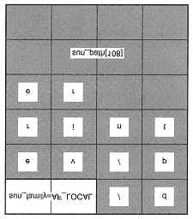
Local(Unix) Socket Address
The structure name for AF_LOCAL or AF_UNIX addresses is sockaddr_un
The sockaddr_un Address Structure
struct sockaddr_un {
sa_family_t sun_family;/* Address Family */
char sun_path[108]; /* Pathname */
};
The structure member sun_family must have the value AF_LOCAL or AF_UNIX
The structure member sun_path[108] contains a valid UNIX pathname
Image shows the physical layout of a socket /dev/printer
Header file for this structure is <sys/un.h>

